Slide 1




Automated testing
for RCP Eclipse based applications
RCPTT Automation
Yuksel Ahmedov
QA Engineer
Quality Assurance Team ltd.
www.qualityassuranceteam.com

Slide 2

Table of Contents
RCP Eclipse Framework
RCP Testing Tool
Demo
ECL Scripting
Resources

Slide 3
Questions
sli.do #RCPTT

Slide 4

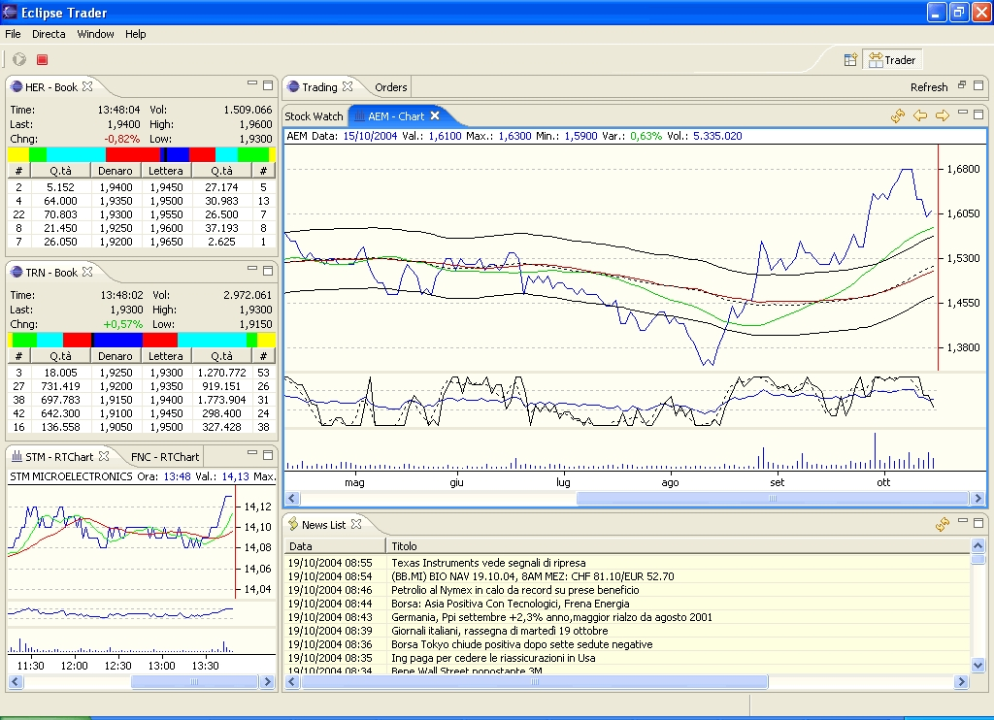
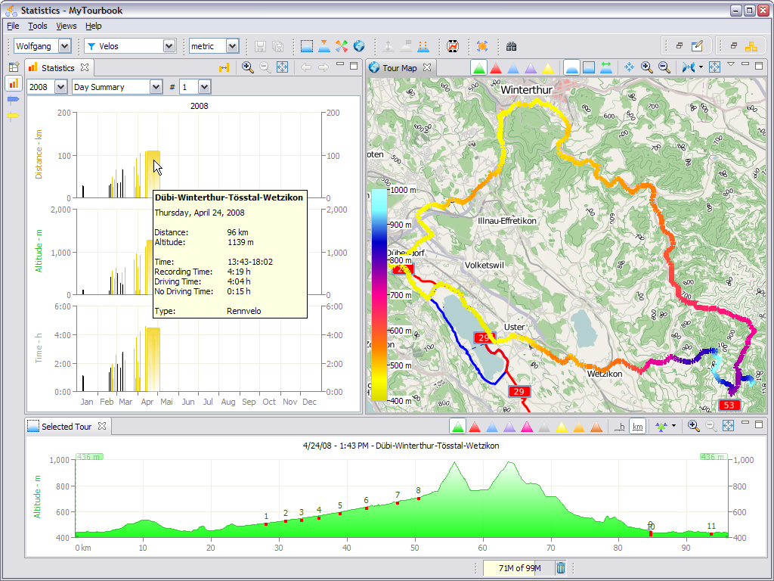
RCP Eclipse Framework
What is it good for?

Slide 5
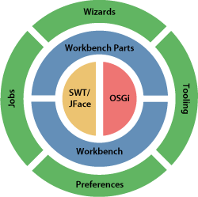
RCP Eclipse Framework
RCP is a collection of lower level frameworks
OSGi – At the lowest level
SWT - Provides the primitive widgets (text controls, radio buttons, etc.)
JFace – Provides a variety of advanced UI functionality controls (wizards, data bindings, preference pages, etc.)
Other Eclipse APIs
Notes:
OSGi - Open Services Gateway initiative
SWT - Standard Widget Toolkit
JFace - Built on top of SWT

Slide 6
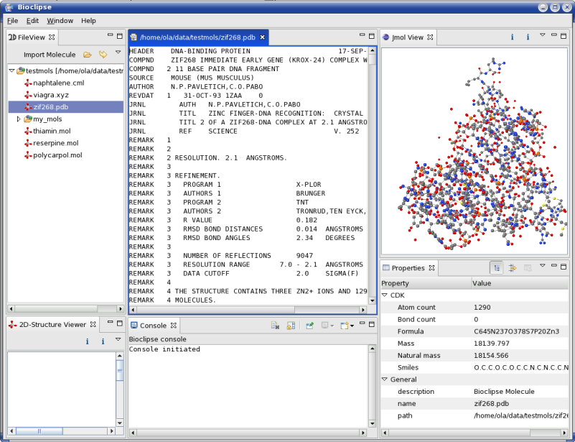
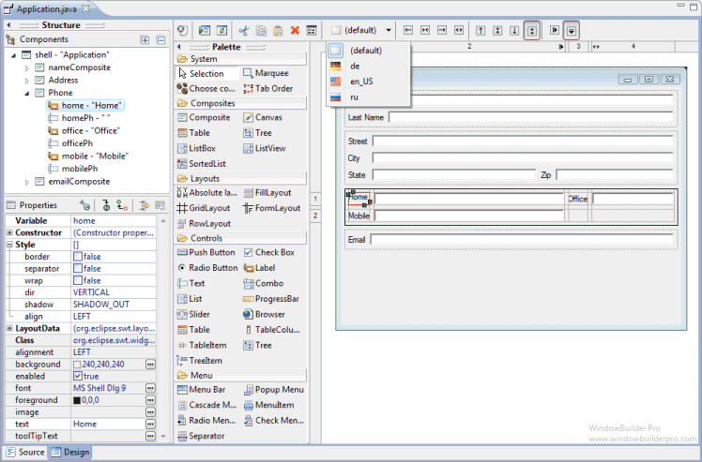
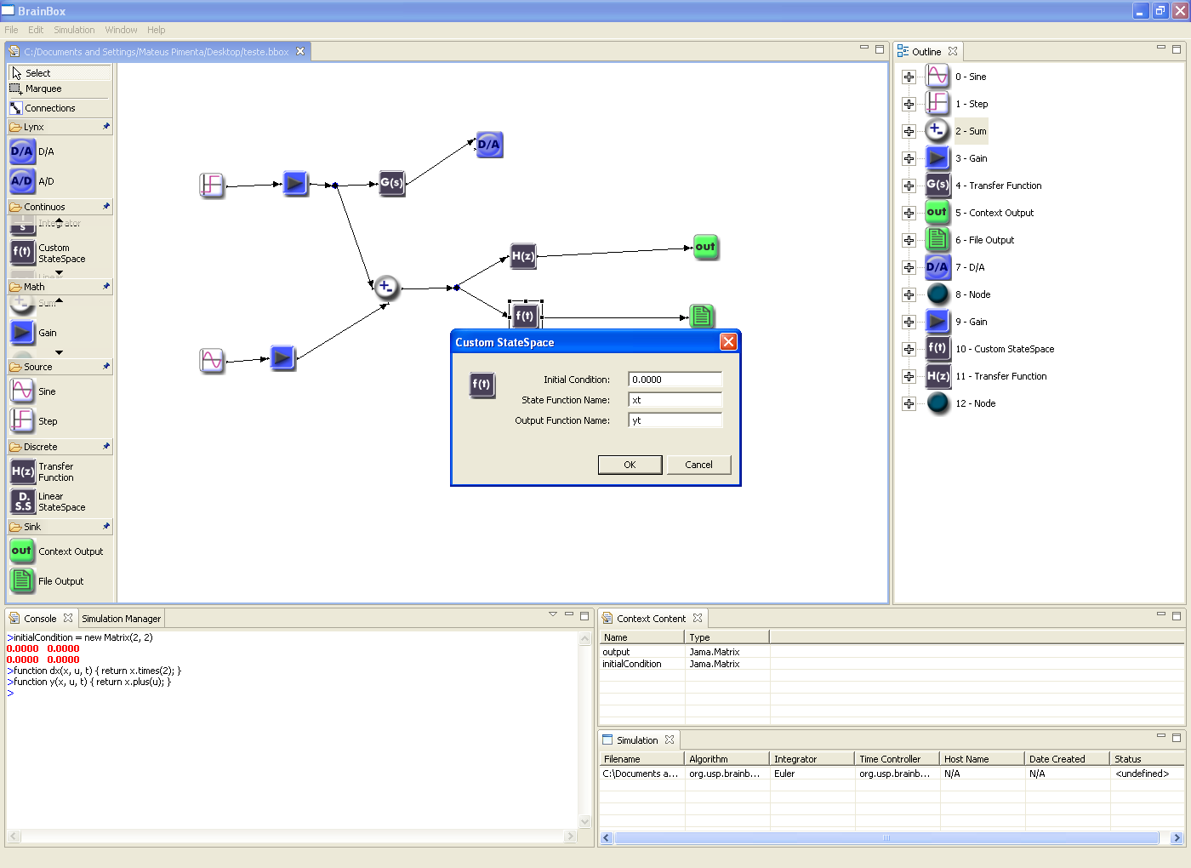
RCP Eclipse Framework
Easily built GUI for Java applications

Slide 7



What is RCPTT?
And why should I care?

Slide 8


RCP Testing Tool
Open source project for GUI testing automation
Extendible functionality and Plugins available
Supported by Eclipse community
Good for Continuous Integration and Delivery
Multi platform
Linux, Windows and MacOS

Slide 9

RCP Testing Tool
Fully aware of the RCP Eclipse internals
Hides application’s inner complexity
No need to deal with wait operations!
Always knows when operation is complete
Easy to setup test Preconditions

Slide 10
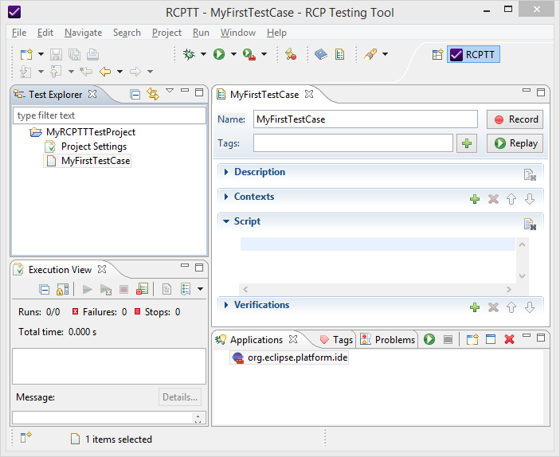
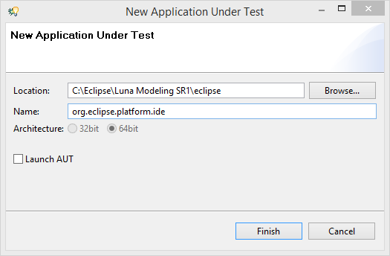
RCP Testing Tool
Powerful IDE
Manage Test Cases and Suites
Record / Replay
Debug
Code reusability
Contexts
Workspaces
ECL Scripts

Slide 11
RCP Testing Tool
Demo!

Slide 12

ECL Scripting
Native language of Eclipse

Slide 13
ECL Scripting
ECL stands for Eclipse Command Language
Able to do virtually anything with Eclipse
get-view "Package Explorer" | get-tree | select testJavaProject | get-menu Delete | click
with [get-window "Delete Resources"] {
get-button "Delete project contents on disk (cannot be undone)" | check
get-button OK | click
}

Slide 14
ECL Test Script
Tests are meaningless without any assertions
Verify your expected result either positive or negative
get-view "Package Explorer" | get-tree | get-property itemCount | equals 0 | verify-true

Slide 15

Summary
RCP Eclipse Framework
ECL Scripting Language
RCPTT
Contexts, Workspaces, Workbenches, etc.
Test Cases, Test Suites, Data Sets , etc.

Slide 16
Useful Links
RCP Testing Tool website:
www.eclipse.org/rcptt/
Sample test cases:
github.com/QualityAssuranceTeam/RCPTT
ECL Documentation:
www.eclipse.org/rcptt/documentation/userguide/ecl
Contribute to community:
wiki.eclipse.org/RCPTT/Contribution_Guide

Slide 17







https://softuni.bg/courses/

Slide 18





Trainings @ Software University (SoftUni)
Software University – High-Quality Education, Profession and Job for Software Developers
softuni.bg
Software University Foundation
http://softuni.foundation/
Software University @ Facebook
facebook.com/SoftwareUniversity
Software University Forums
forum.softuni.bg

